Slide 1

Plan My Day Agent
Copilot Scenario Overview
© 2026 Microsoft Corporation All rights reserved.
Notes:
CELA disclaimer
Terms displayed or discussed are for explanation/education only. Such terms may differ from your agreement.

Slide 2
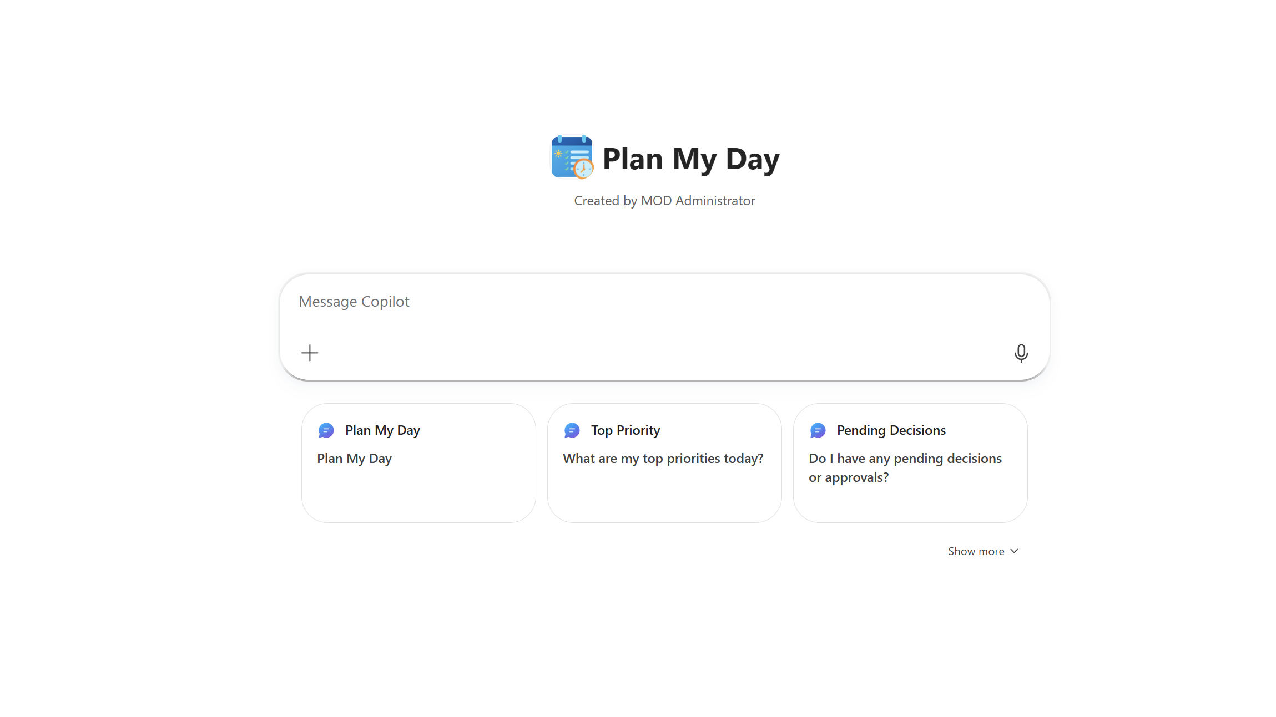

Plan My Day Agent Summary
Agent Overview
Key Challenges
Plan My Day helps employees quickly understand what matters most each day by bringing together meetings, tasks, emails, and documents into a single, time‑aware briefing. With one simple prompt, users start their day prepared, focused, and ready to act, without jumping between tools.
Fragmented daily planning workflow
High cognitive load across key roles
Missing or overlooked signals (tasks, emails, chats)
Business Outcomes
⏱️ Reduced daily planning time
🎯 Helps employees focus on what’s important
😊 Improved employee satisfaction
Technical Features
🗓️ Daily & Time‑Aware Briefings
📅 Calendar & Meeting Intelligence
✅ Task & Priority Management
📊 Weekly Planning & Outlook
📄 Document Awareness
Notes:
CELA disclaimer
Terms displayed or discussed are for explanation/education only. Such terms may differ from your agreement.

Slide 3
Table of Contents
Overview
Persona Example
User Journey Scenario Example
Solution Screenshots
Demo Prompts
Notes:
CELA disclaimer
Terms displayed or discussed are for explanation/education only. Such terms may differ from your agreement.

Slide 4

The Plan My Day Agent helps employees quickly understand what matters most each day by bringing together meetings, tasks, emails, and documents into a single, time‑aware briefing. With one simple prompt, users start their day prepared, focused, and ready to act, without jumping between tools. The agent orchestrates data across Microsoft 365, generates a structured briefing ensuring every user begins the day prepared, aligned, and focused.
Overview
© 2026 Microsoft Corporation All rights reserved.

Slide 5


Persona Example
From executive assistants piecing together briefings to managers racing between meetings, the Plan My Day Agent eliminates the burden of scanning tools.
Alicia
Mark
Executive Assistant
Senior Manager
Scans Outlook, Teams, and notes daily to piece together VP briefings - a 30-minute ritual
Needs a unified view of meetings, updates, documents, and critical follow-ups
Spends mornings in transit, preparing between back-to-back meetings with fragmented context
Hunts for emails and lost context, which slows preparation and decision-making
💬Typical Ask
💬 Typical Ask
"Prepare the day - pull together all meetings, emails, and action items for this morning."
"Brief me for my next meeting -- agenda, context, attendees, and decisions at a glance."
Key Challenges Addressed
Fragmented daily preparation workflow; high cognitive load across key roles; missing or overlooked signals; no unified "digital day folder"

Slide 6
User Journey
One prompt triggers a full orchestration across Microsoft 365 -- calendar, email, Teams, attachments -- and delivers a structured digital day folder.
1
Trigger
2
Evaluation
3
Digital Day Summary
Employee asks, "Prepare my day." Agent reviews the user's calendar, checks new emails and Teams messages, and looks for anything that might affect today's preparation.
Agent evaluates what is relevant, determines whether new information changes the shape of the day, summarizes the schedule, and compiles key meeting insights, documents, and follow-ups.
Result delivered as an up-to-date status reflecting the latest meetings, priorities, and follow-ups -- assembled from Outlook calendar, email, Teams messages, attachments, and existing notes.
Backbone
On-demand briefing
Follow-up extraction
Microsoft 365 data sources

Slide 7







High Level Agent Architecture
Plan my day Agent
Declarative agent
Email
Calendars
Attachments
Plan my day
Agent
Retrieve
Messages
Instructions
User
Trigger Example
User asks
“Prepare My Day”
Files

Slide 8
Agent Solution Screenshots
© 2026 Microsoft Corporation All rights reserved.
Notes:
CELA disclaimer
Terms displayed or discussed are for explanation/education only. Such terms may differ from your agreement.

Slide 9
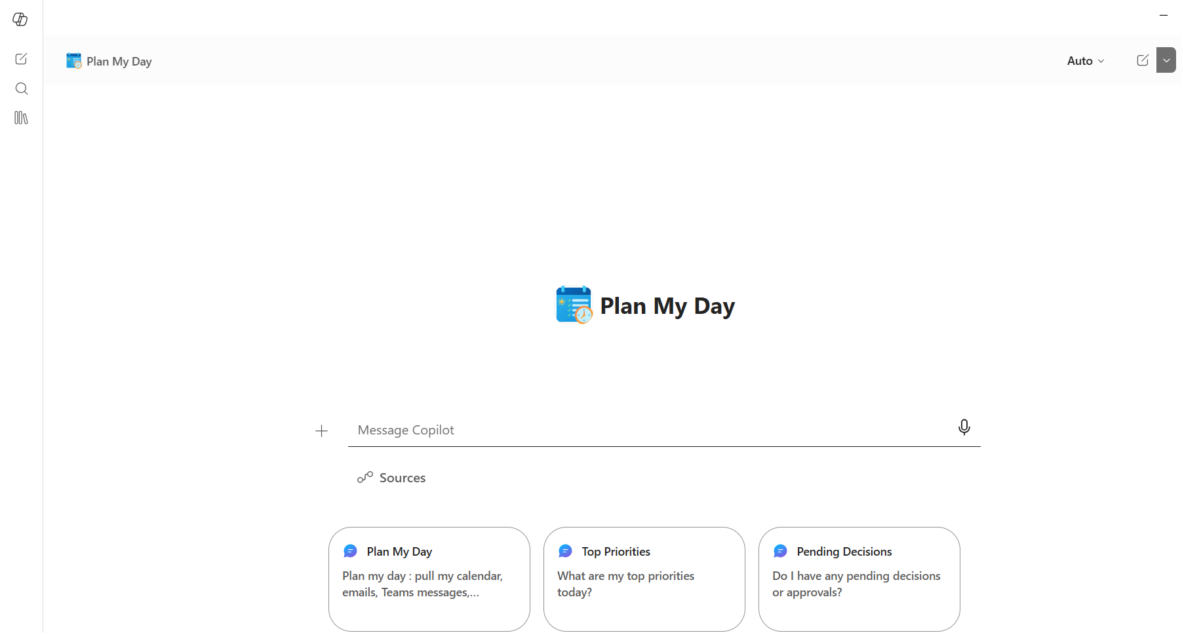
Trigger
Notes:
CELA disclaimer Terms displayed or discussed are for explanation/education only. Such terms may differ from your agreement.

Slide 10
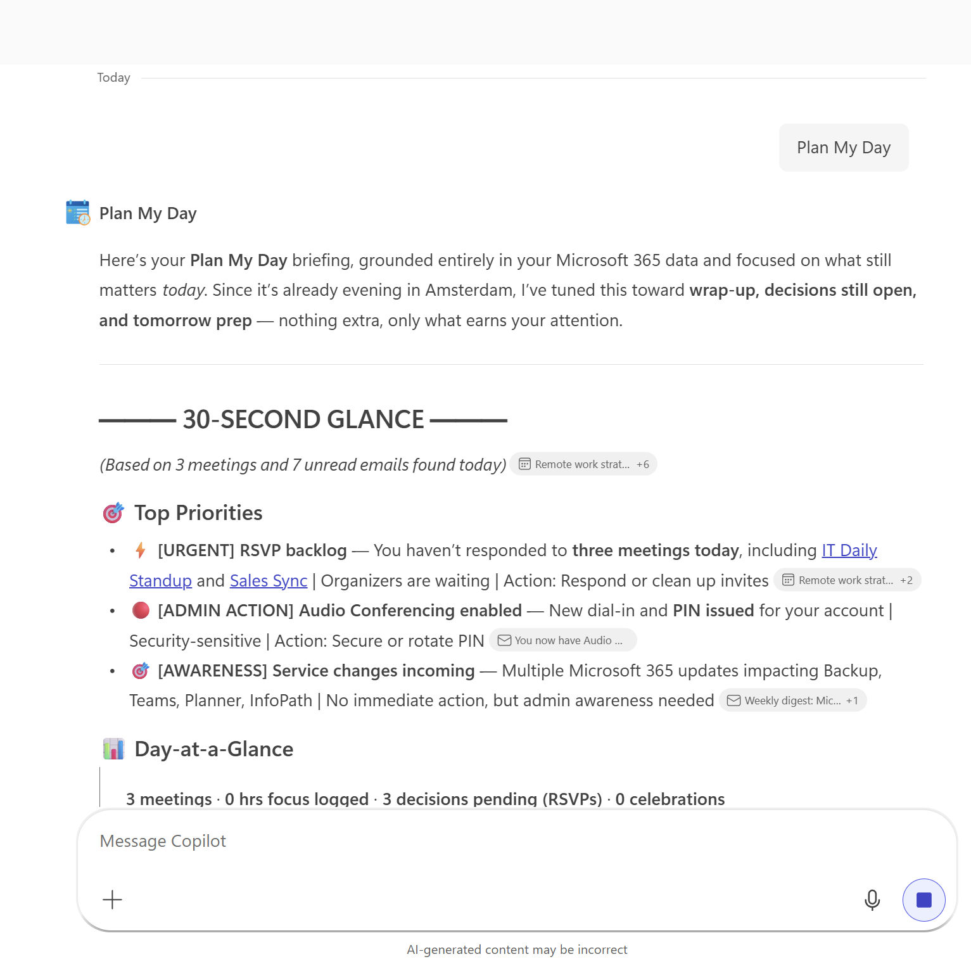
Output
Notes:
CELA disclaimer Terms displayed or discussed are for explanation/education only. Such terms may differ from your agreement.

Slide 11
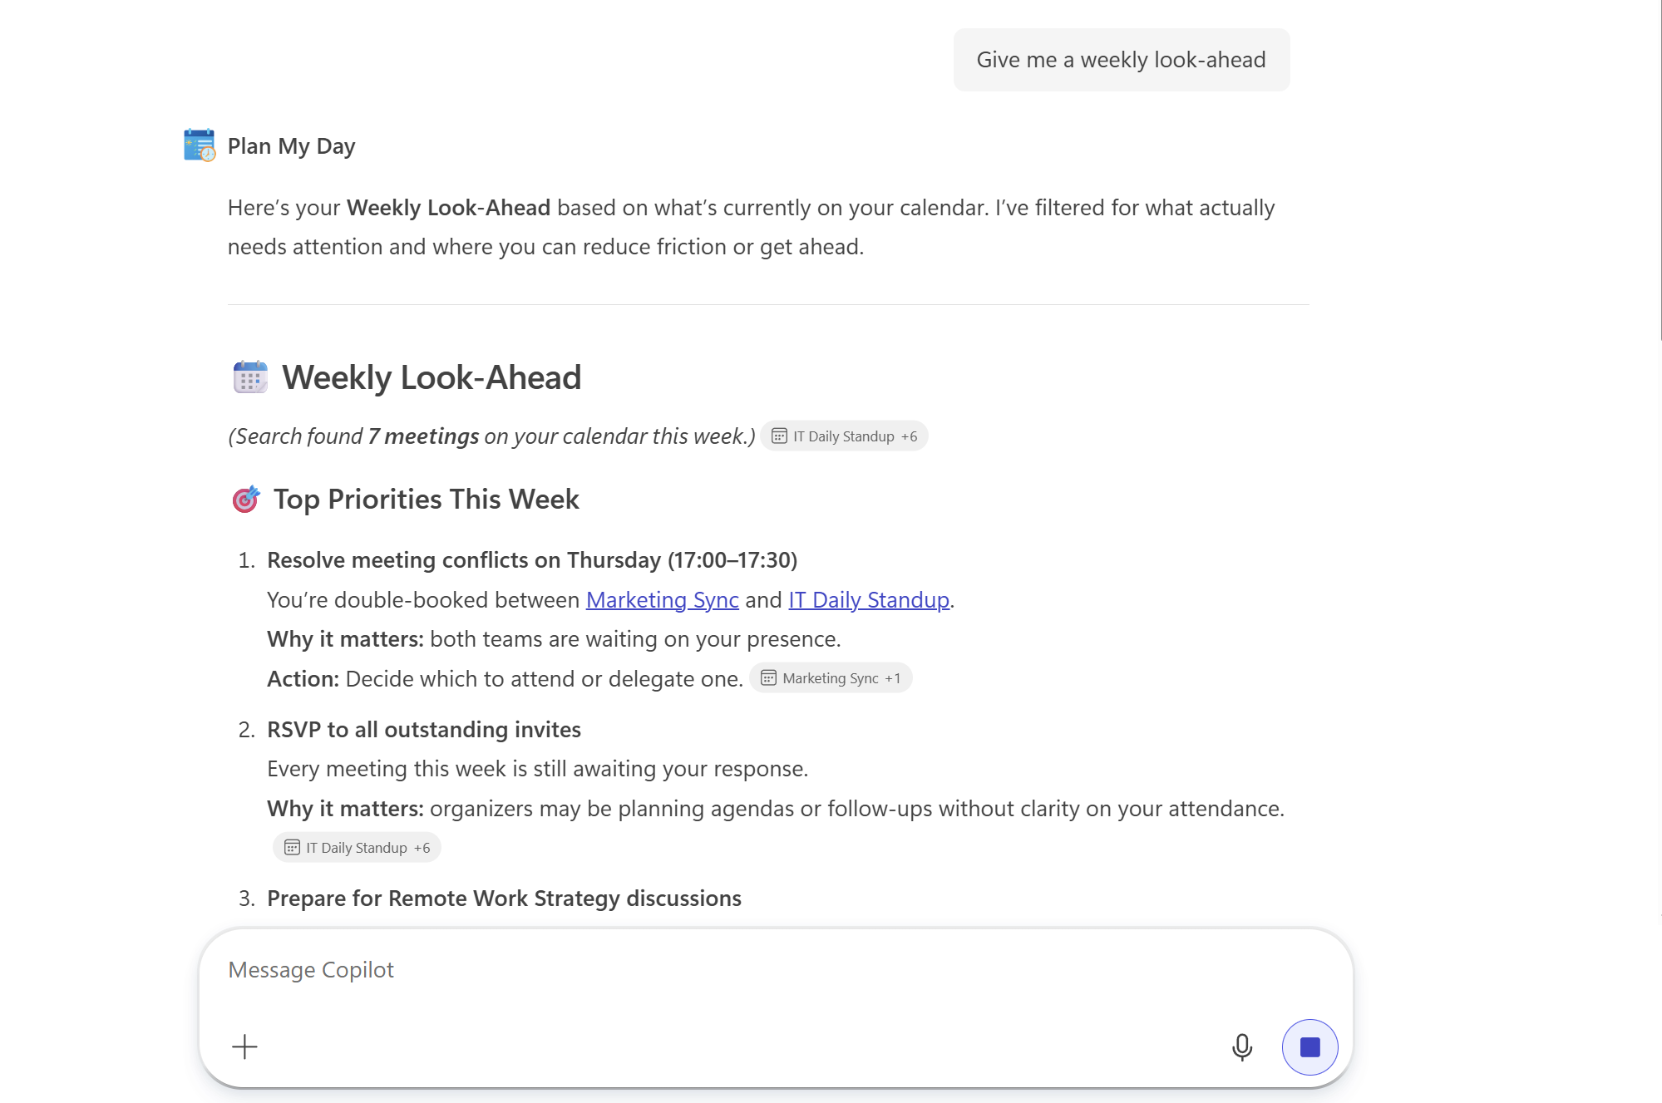
Output
Notes:
CELA disclaimer Terms displayed or discussed are for explanation/education only. Such terms may differ from your agreement.

Slide 12
Demo Prompts
© 2026 Microsoft Corporation All rights reserved.
Notes:
CELA disclaimer
Terms displayed or discussed are for explanation/education only. Such terms may differ from your agreement.

Slide 13
Demo Prompts
Id | Test Scenario | Prompt | Expected Result
1 | Morning Briefing | "Prep my day" | Verify it returns calendar, tasks, emails, and priorities
2 | Calendar Overview | "What does my day look like?" | Verify it lists meetings with times, conflicts, and focus blocks
3 | Task Priorities | "What are my top priorities and tasks?" | Verify it pulls from Planner/To Do and ranks by urgency
4 | Comms Catch-Up | "What did I miss?" | Verify it surfaces key emails and Teams mentions since last active
5 | Pending Decision | "Do I have any pending decisions or approvals?" | Surfaces items where others are blocked waiting on your input
6 | Urgent Email | "What urgent emails need my attention?" | Lists priority communications from VIPs and flagged senders
7 | Teams Summary | "Summarize my Teams messages" | Reviews unread @mentions, direct messages, and active channel threads
8 | Document Review | "What documents need my review?" | Shows recent SharePoint and OneDrive activity that requires your attention
9 | Meeting Prep | "Prep me for my [next meeting]" or "Am I prepared for my next meeting?" | Verify it shows attendees, agenda, related docs, and action items
10 | Afternoon Check-In | "What's my afternoon look like?" | Verify it adjusts for current time
11 | End of Day Wrap | "Wrap my day" | Verify it summarizes completed items and previews tomorrow
12 | Weekly Look Ahead | "Give me a weekly look ahead" | Provides the full week summary with milestones, stats, and priorities
13 | Delegation | "What should I delegate today?" | Recommends meetings and tasks that could be handled by someone else
14 | Meeting Load | "How heavy is my meeting load today?" | Shows day stats with meting hours vs available focus time break
15 | Ambiguous Prompt | "Help me get ready" | Verify it infers intent or asks clarifying question

Slide 14
Thank You
Notes:
CELA disclaimer
Terms displayed or discussed are for explanation/education only. Such terms may differ from your agreement.

